Slide 1
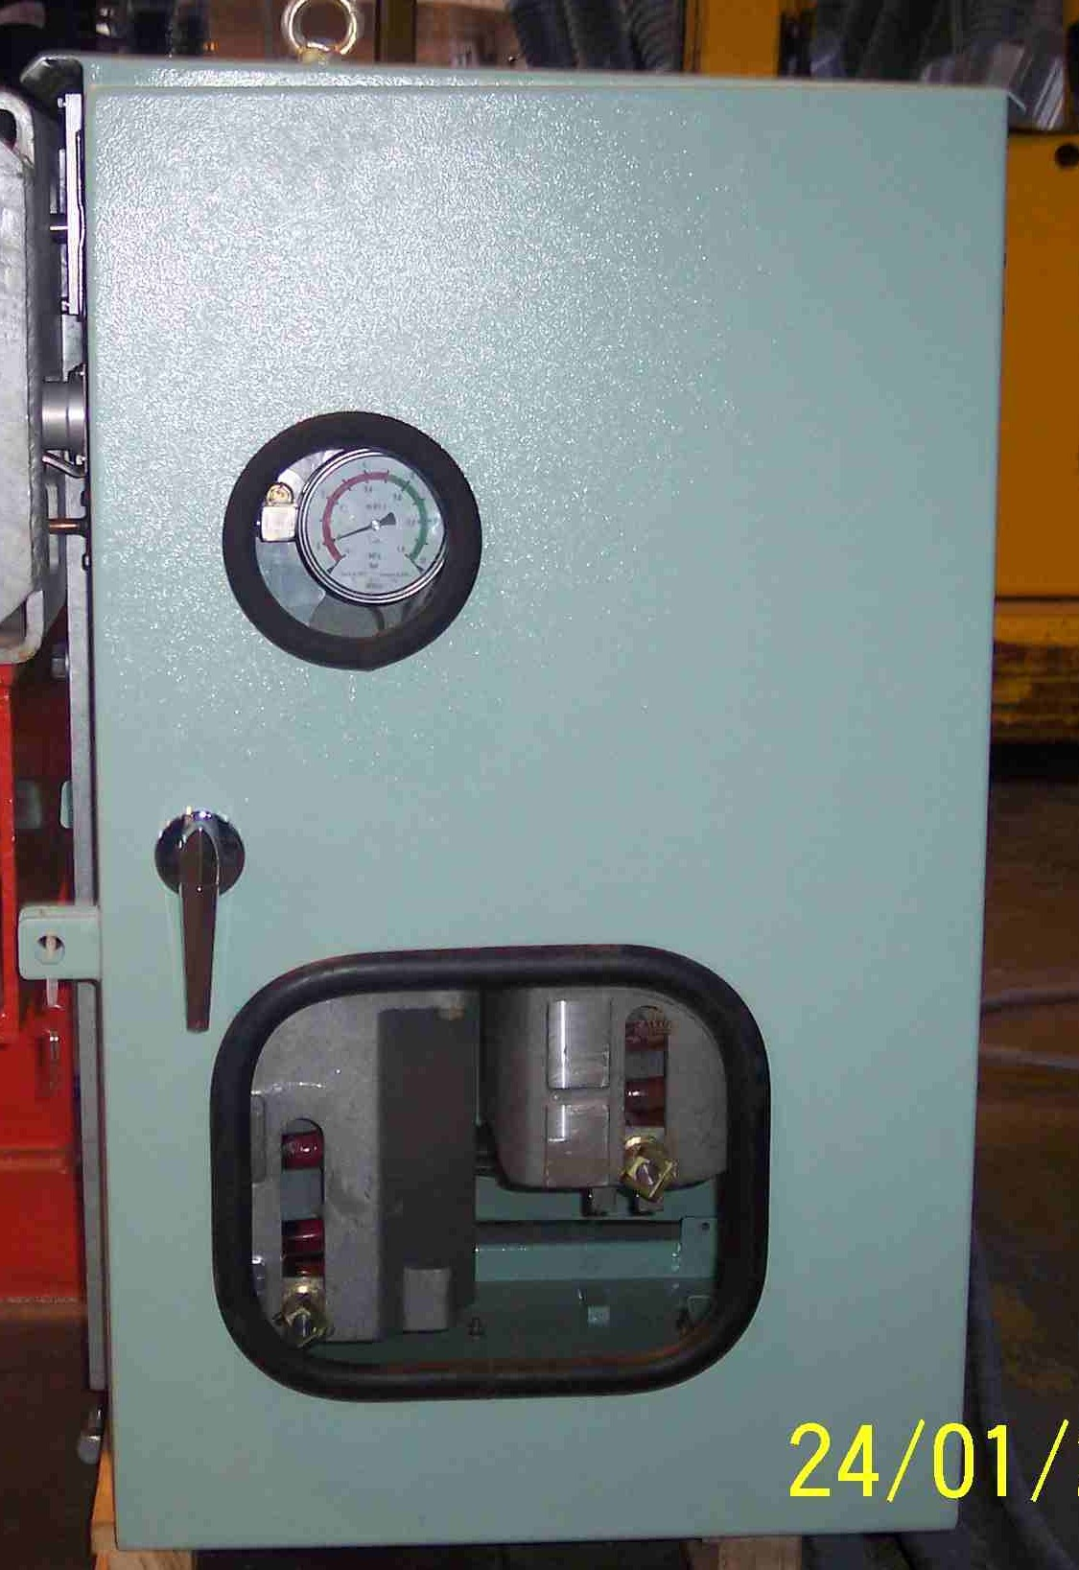
SIEMENS
HVCB SPARES
Drive Mechanism with Panel
245KV CB
S4711303717

